Slide 1


Open-Source Photogrammetry With
Stephen Mather, Oberlin College
Corey Snipes, Twomile Heavy Industries Inc
IFRC Drones Group – January 26, 2022

Slide 2
INTRODUCTIONS

Slide 3
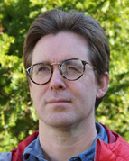

Stephen Mather
Systems Administrator with Focus on Research Support, Oberlin College and Conservatory
OpenDroneMap Ecosystem cofounder (with Piero Toffanin)
Specialize in large-scale elevation model creation from photogrammetry
Writing:
Co-Author of the PostGIS Cookbook
Blog at https://smathermather.com
Certified Remote Pilot (US FAA Part 107)
Notes:
Background in geography, planning, specialization in optical and radar remote sensing, GIS, and biophysics with a touch of glaciology

Slide 4

Corey Snipes
Aerospace Software Engineer
Focus: Air Traffic Management, Cybersecurity
Part 107 Commercial UAS Pilot
Focus: Mapping and Modeling in Urban and Coastal Contexts
Board President, North Coast Drone Alliance
Based in Cleveland, Ohio

Slide 5
AGENDA

Slide 6
Agenda
What is ODM?
Benefits
Capabilities
Use Cases
Getting Started
Learning More
Getting Involved

Slide 7
WHAT IS ODM?

Slide 8
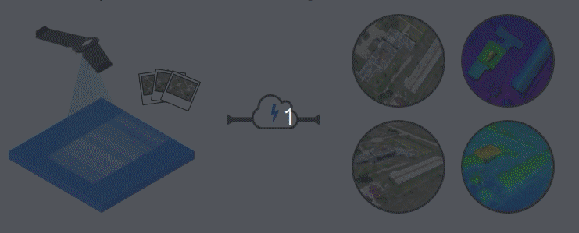
Overview
Open-source toolkit for photogrammetry from UAS imagery and sensor data
Used globally across all sectors
Government
Cleveland Metroparks
Korea National Park Service
US Department of Interior
NGO
Used by the Red Cross, World Bank, United Nations
Private sector
10s of thousands of users
Hobbiest
Animation via webodm.net
Begun in 2014, significant improvements 2018-2021
Output Quality
Features
Usability

Slide 9
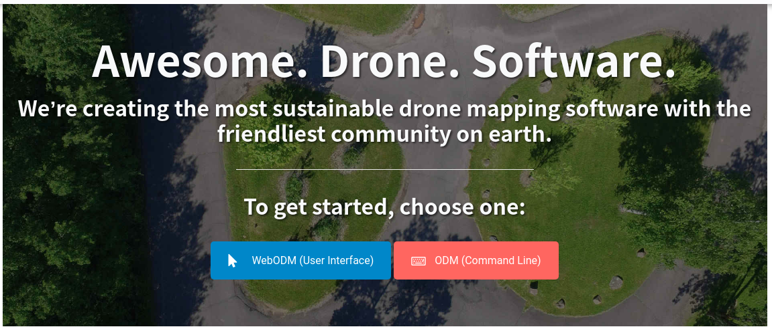
OpenDroneMap Goals
Humanitarian
Ecology, conservation
Research
Data for the public good

Slide 10




OpenDroneMap Funding
Community Contributions
Cleveland Metroparks
ELHRA's Humanitarian Innovation Fund
World Bank Tanzania and Global Facility for Disaster Reduction and Recovery
American Red Cross
Korea National Park Service
Via associated projects, e.g. OpenSfM and OpenMVS
​Via commercial funding via WebODM.net:​
Notes:
Funded by Cleveland Metroparks
ELHRA's Humanitarian Innovation Fund
American Red Cross
World Bank Tanzania and Global Facility for Disaster Reduction and Recovery

Slide 11
BENEFITS

Slide 12
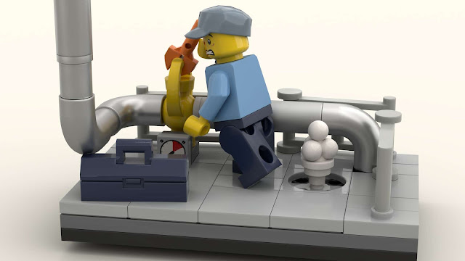
Why Open Source
Shared Costs
Accessible to orgs and programs with limited budgets
Pix4D is $292-$350/mo -OR- $4,990 one-time
ODM is $0* (free as in freedom forever)
But equally important:
Control over your toolchain (change if you want)
Shoulders of giants: many contributors, collective wisdom
Transparency leads to greater
Quality
Security
Standards Based
Public Good
https://www.newelementary.com/2020/06/lego-part-65581-lantern-techniques-3.html
Use of Proprietary Software in the Aid Sector Perpetuates Racial Injustice
https://ivangayton.net/
*You can pay for certain parts, but not required.

Slide 13
CAPABILITIES

Slide 14
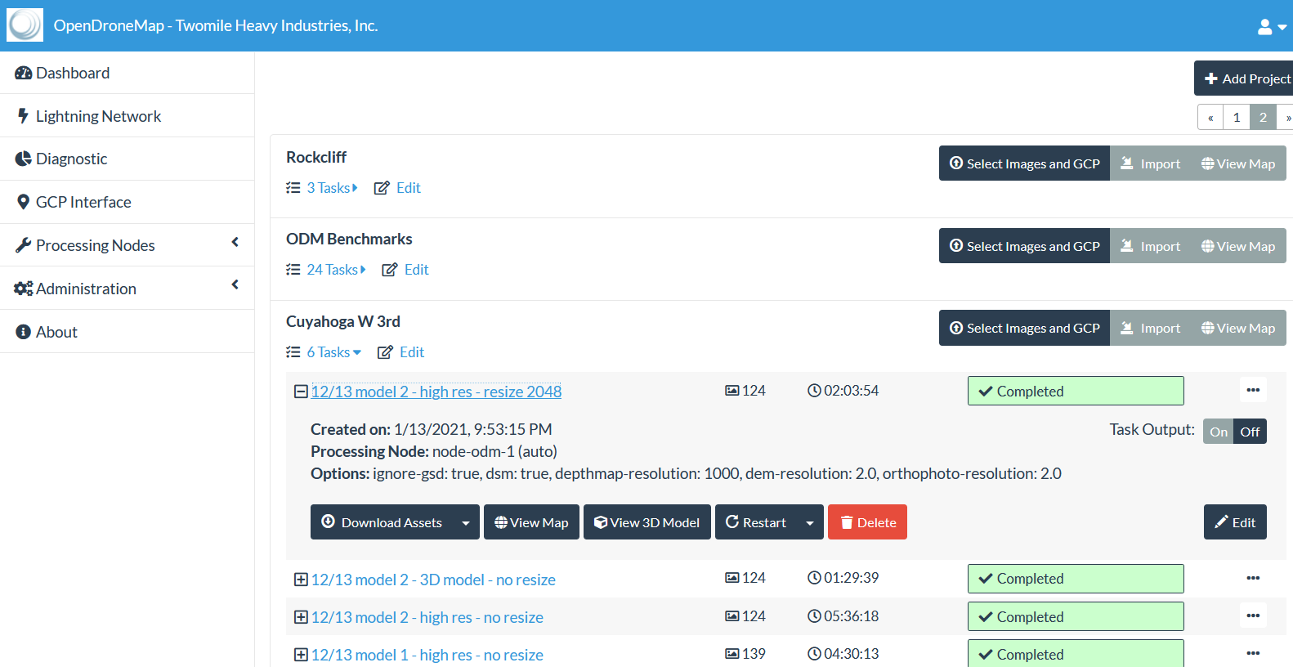
Dashboard

Slide 15
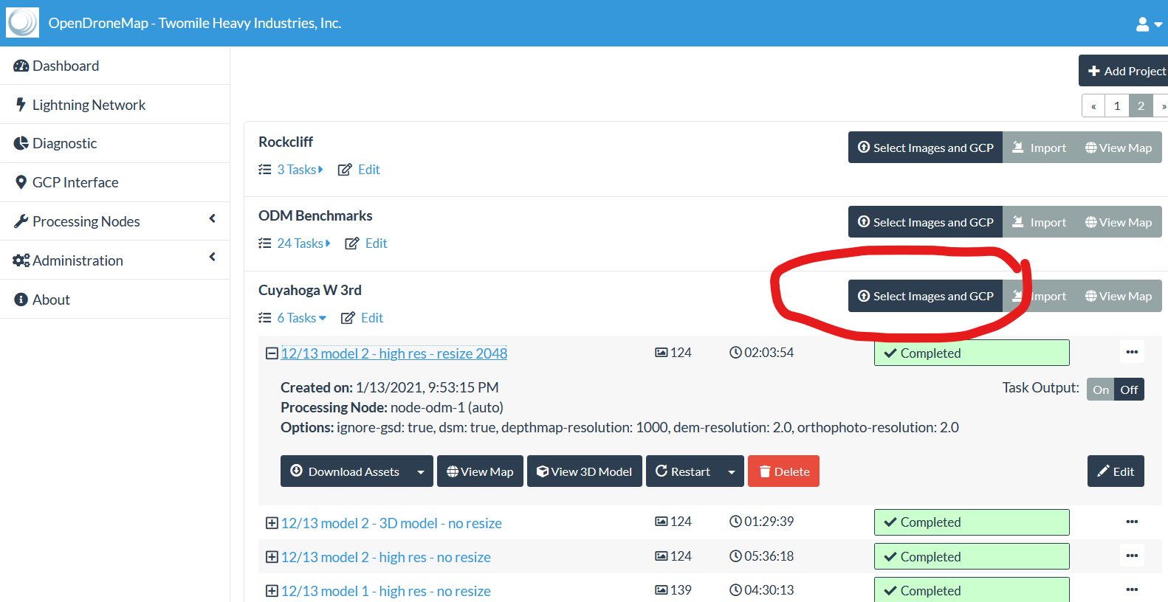
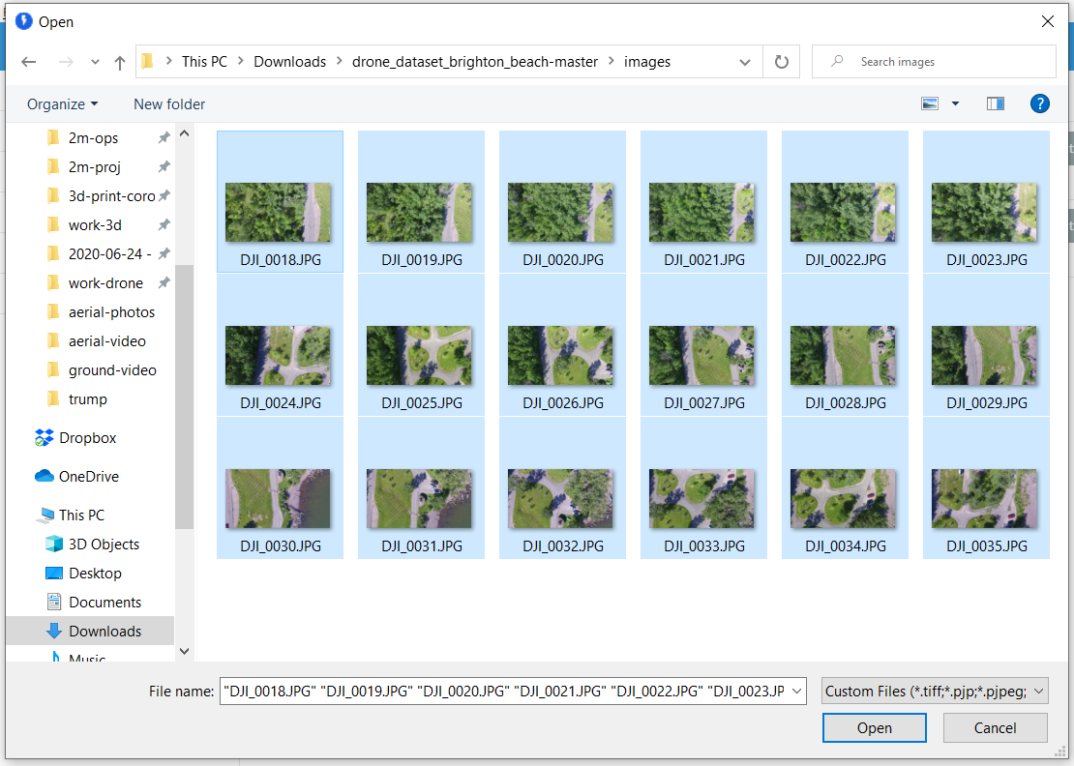
Add Images

Slide 16
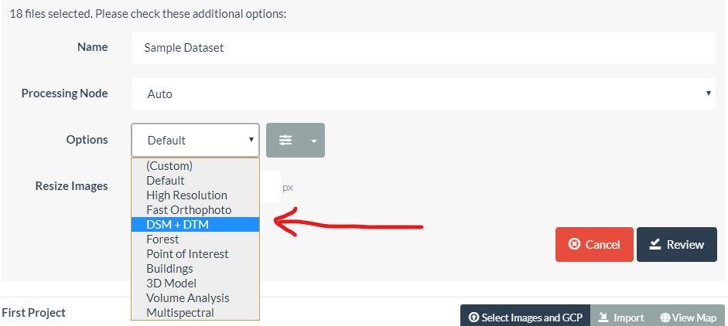
Set Configuration

Slide 17
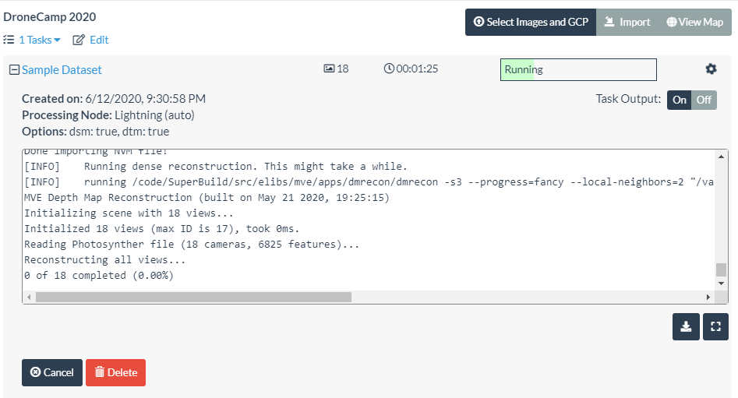
Processing

Slide 18
Finished

Slide 19
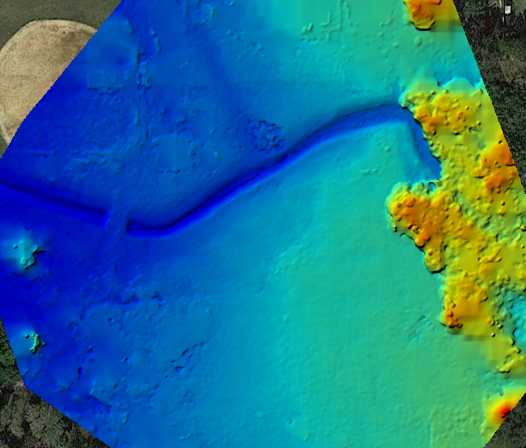
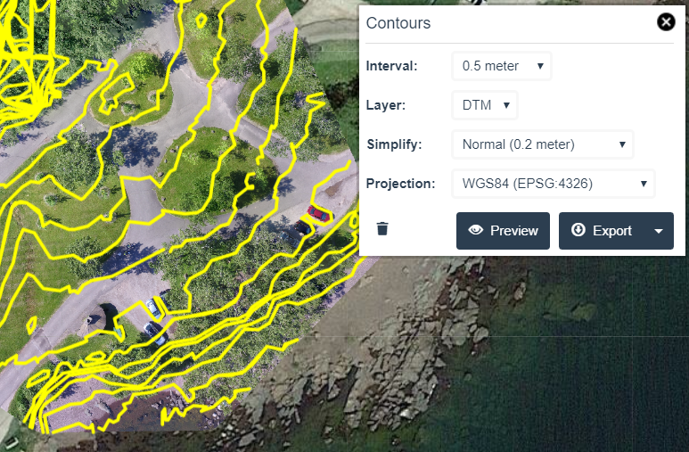
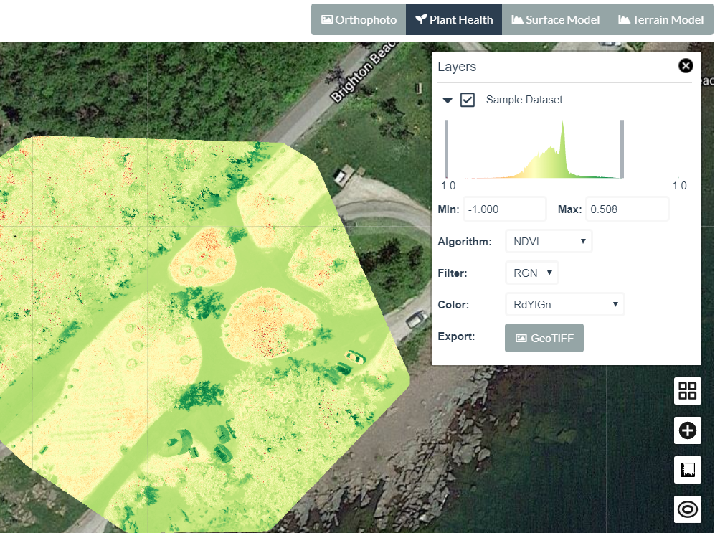
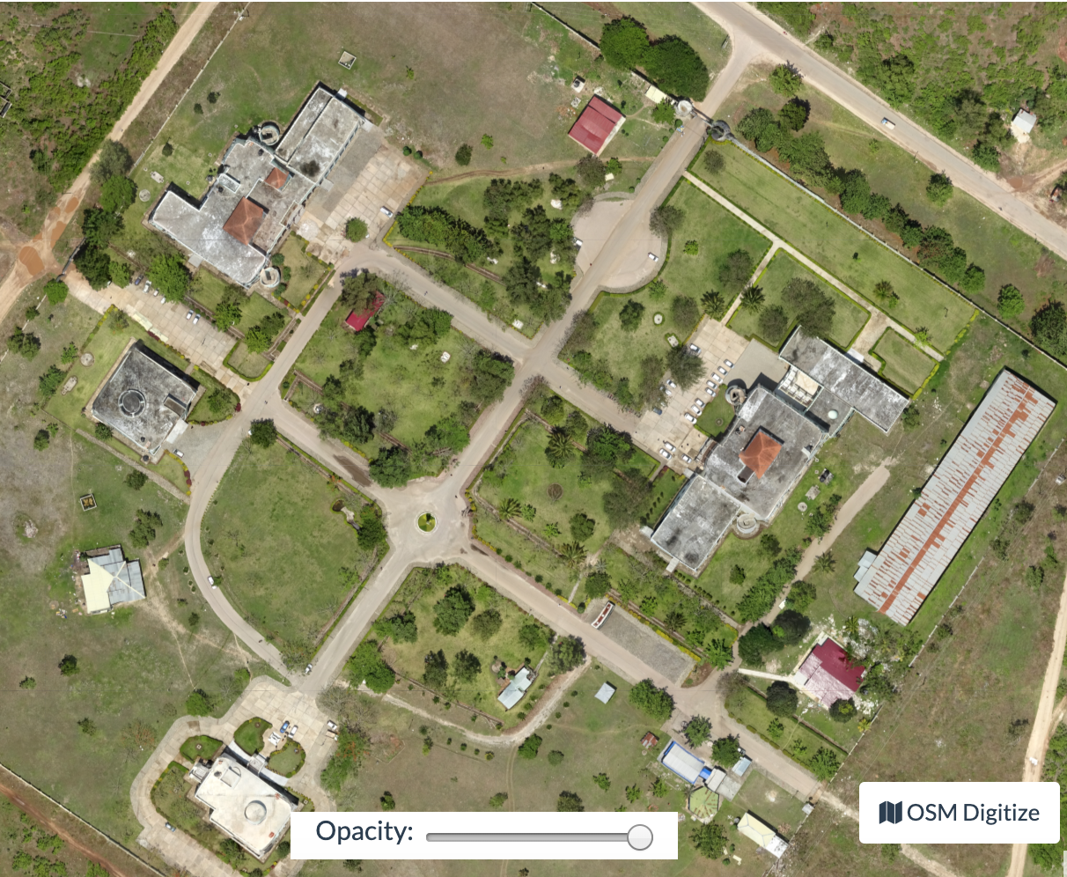
2D Outputs
DSM / DTM / Contours
Plant Health
Orthophoto (GeoTIFF)
🡪 QGIS/ArcGIS
🡪 Object detection/counting via FieldMapR, rastervision.io
Photo Credit: opendronemap.org

Slide 20
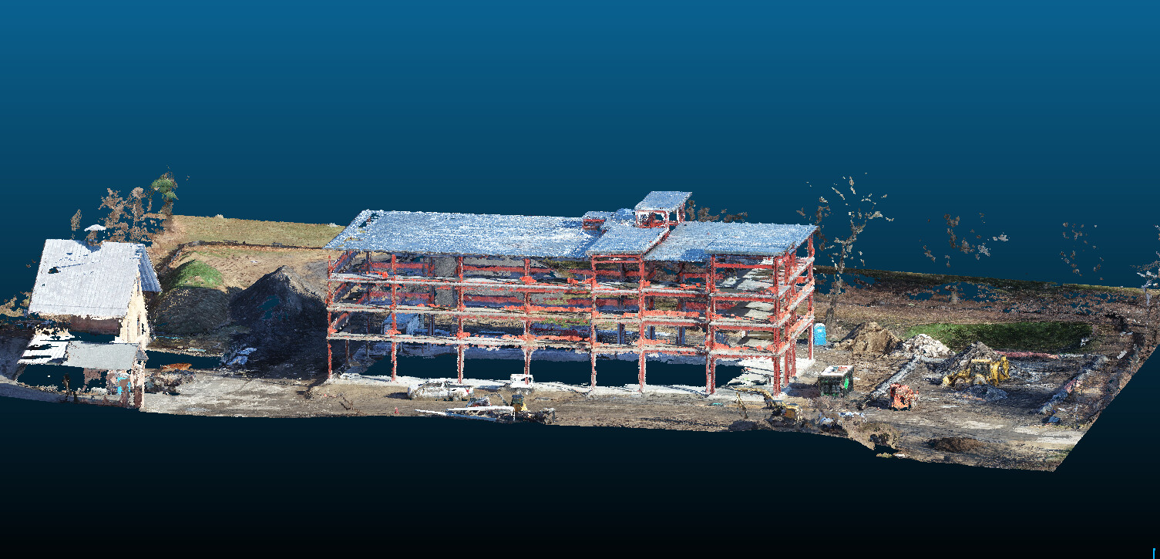
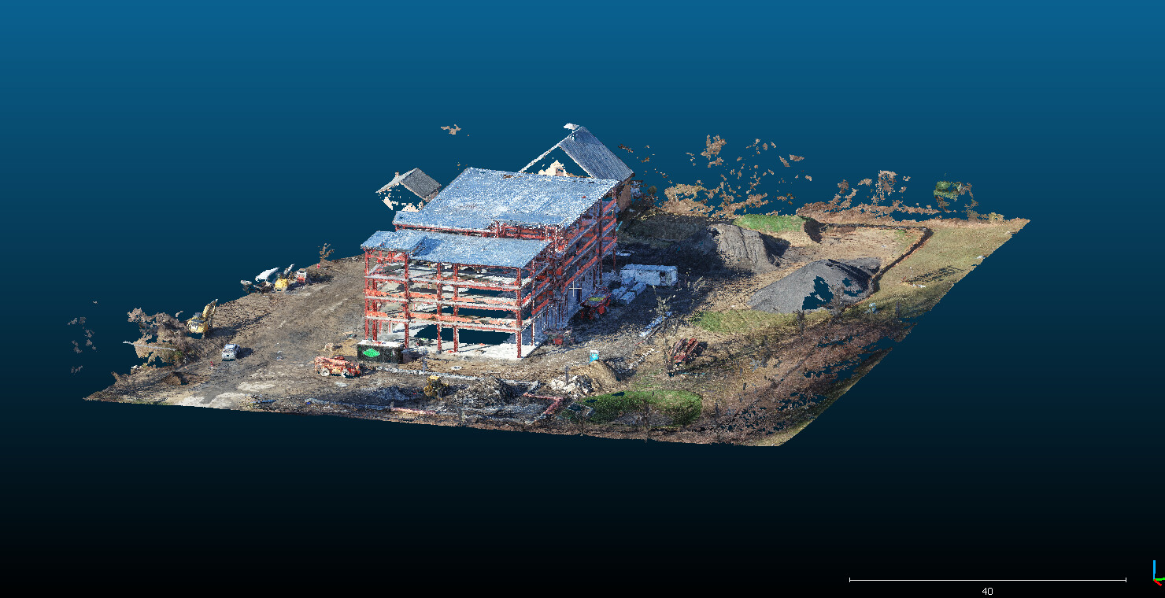
3D Outputs
Dense Point Cloud (.las/.laz)
🡪 CloudCompare, etc for analysis
Photo Credit: Joseph Fazioli

Slide 21
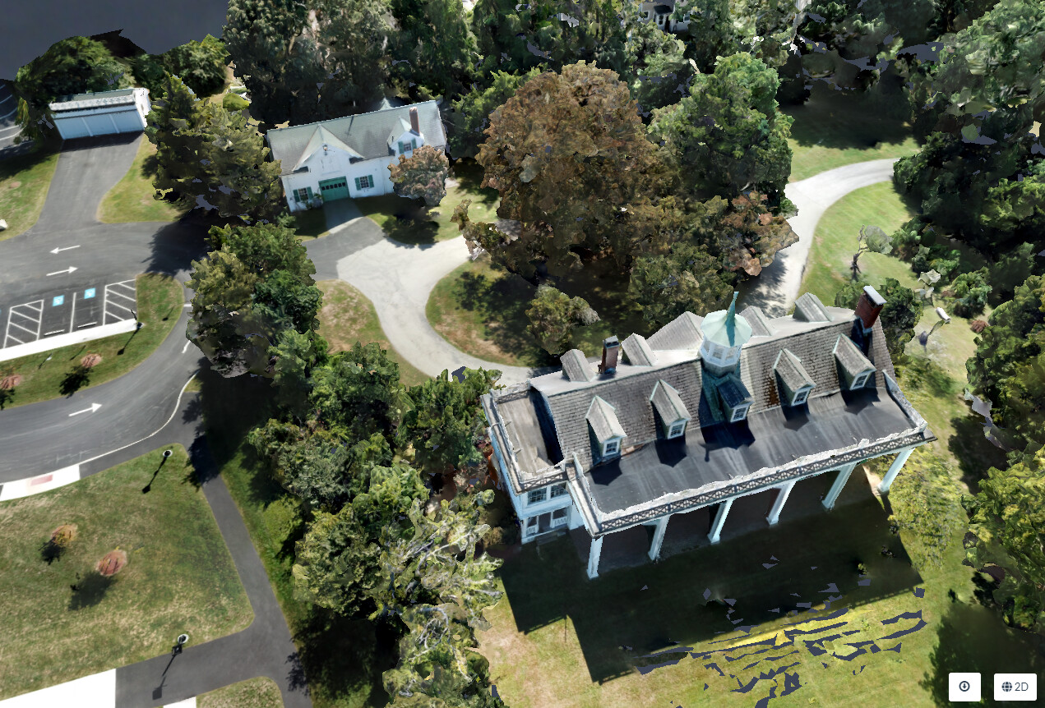
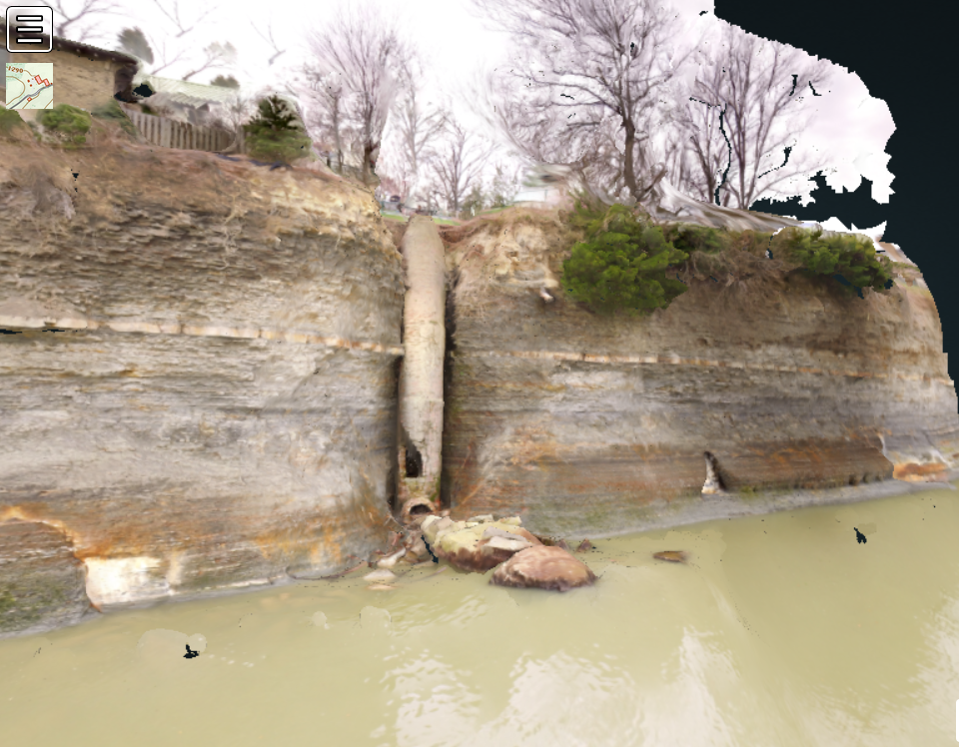
3D Outputs
Textured 3D Model (.obj)
🡪 Sketchfab, et al for sharing
🡪 CAD, Blender
🡪 3D print
Photo Credit: Jamie Portolese, Corey Snipes

Slide 22
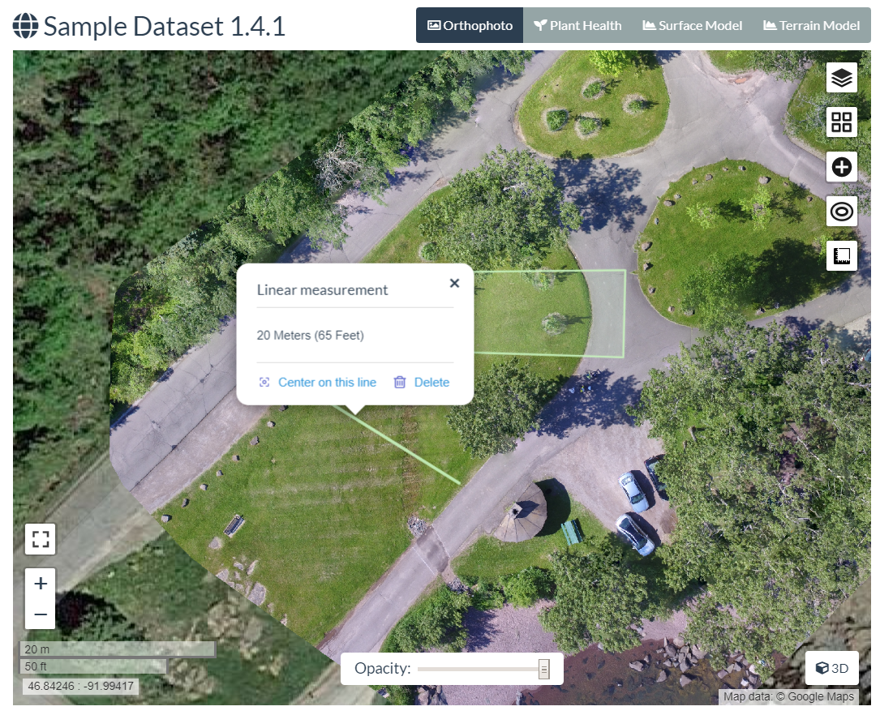
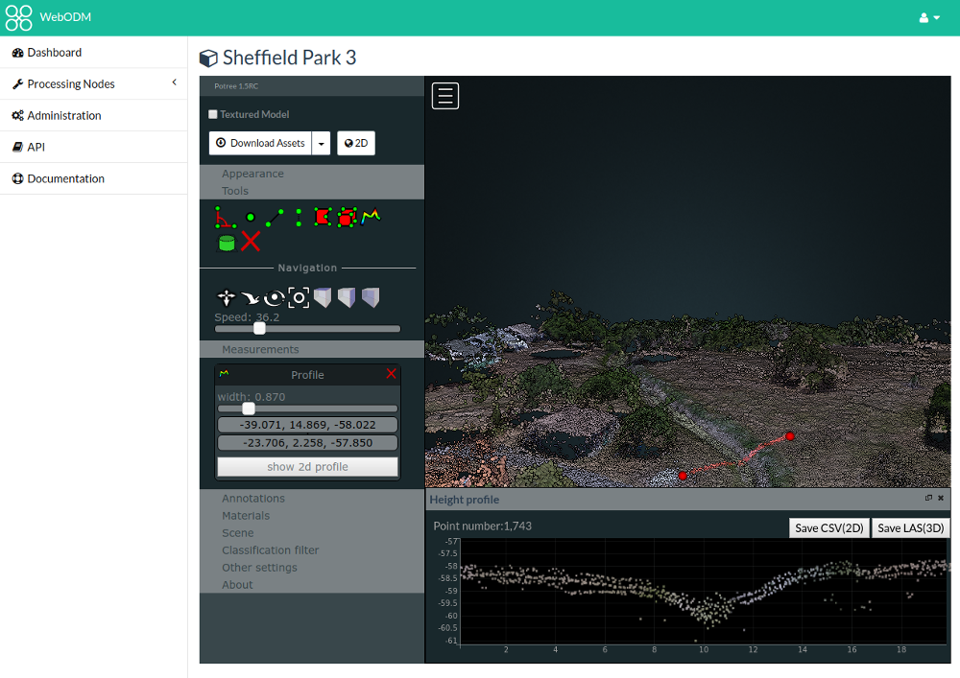
Within ODM
Measurement
Analysis

Slide 23
USE CASES

Slide 24
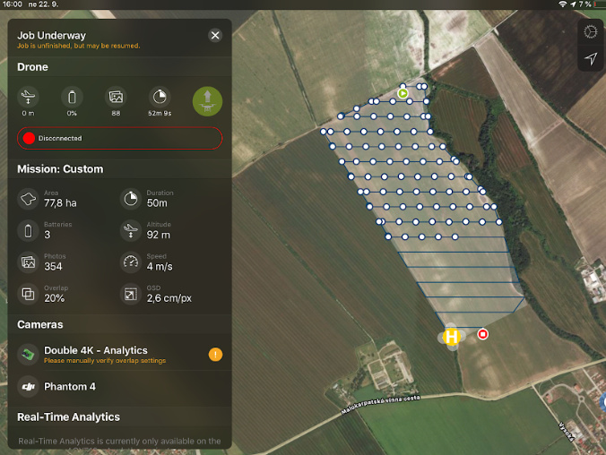
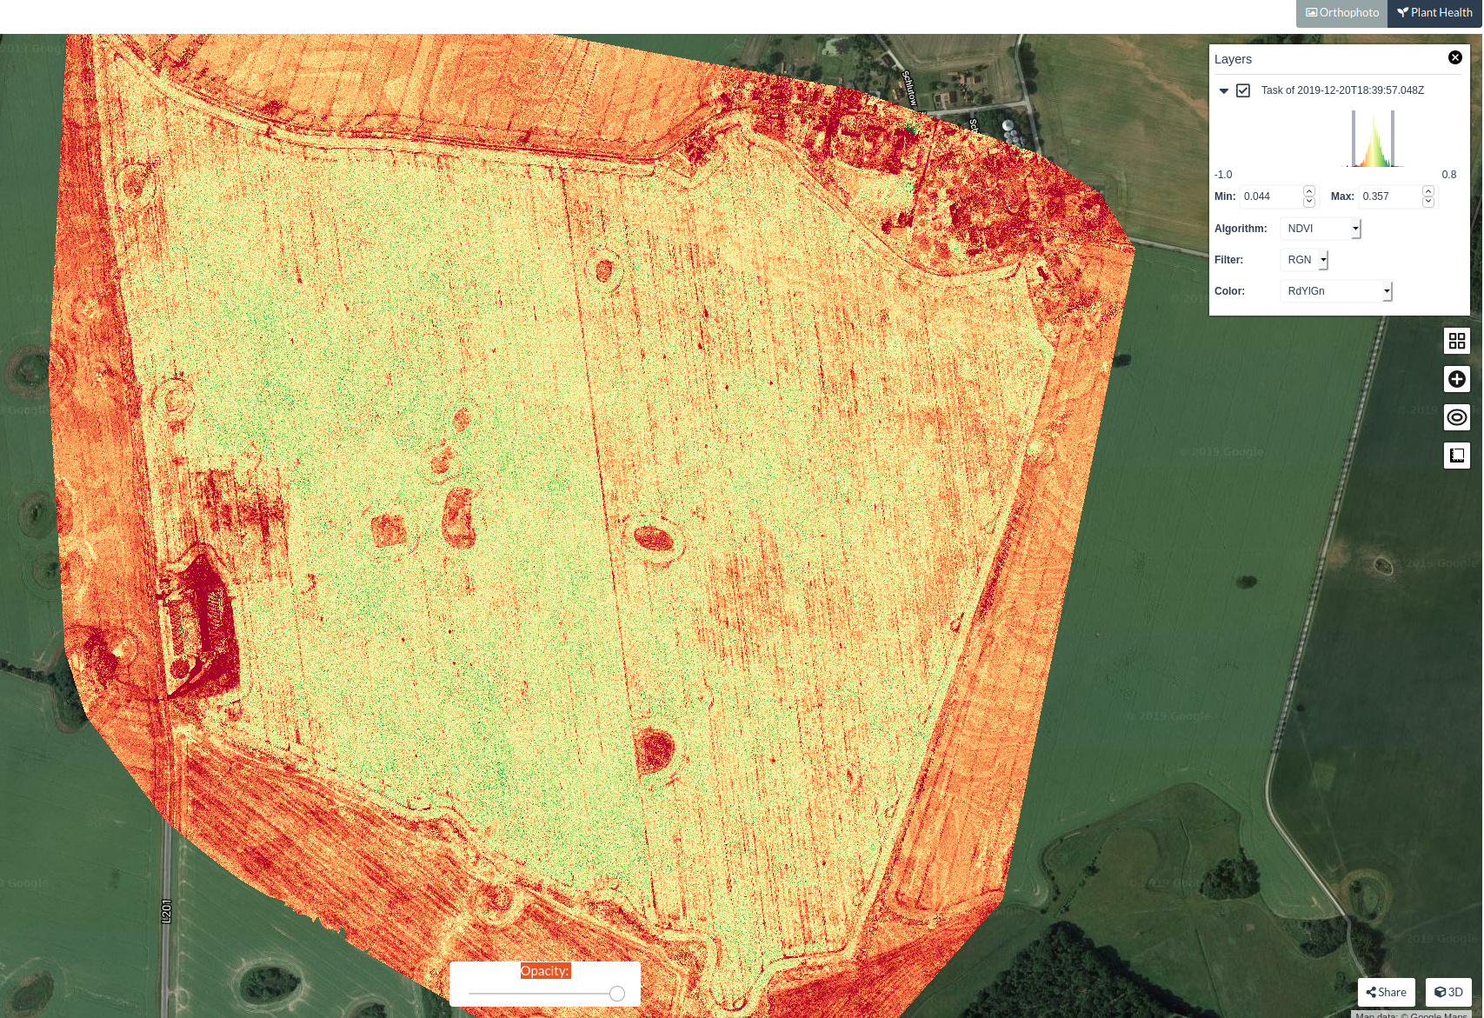
Agriculture
Drone with multispectral camera
Capture biweekly images of a large field
Use ODM plant health algorithms
Visually monitor crop health
Highlight areas of plant stress, for focused attention
Image: community.opendronemap.org

Slide 25
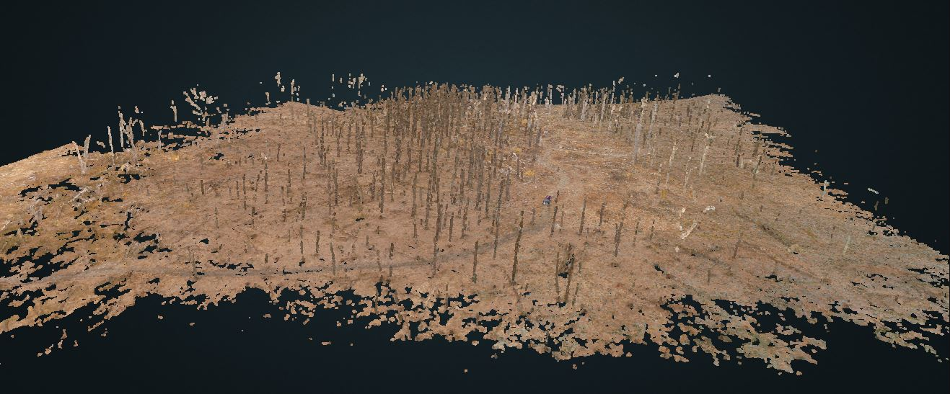
Emergency Management
Drone with standard camera
Quickly map a tornado zone
Use ODM to identify and quantify damage areas
Prioritize resources, work
Estimate re-planting costs/effort
Repeat flights to monitor progress
Image: opendronemap.org

Slide 26
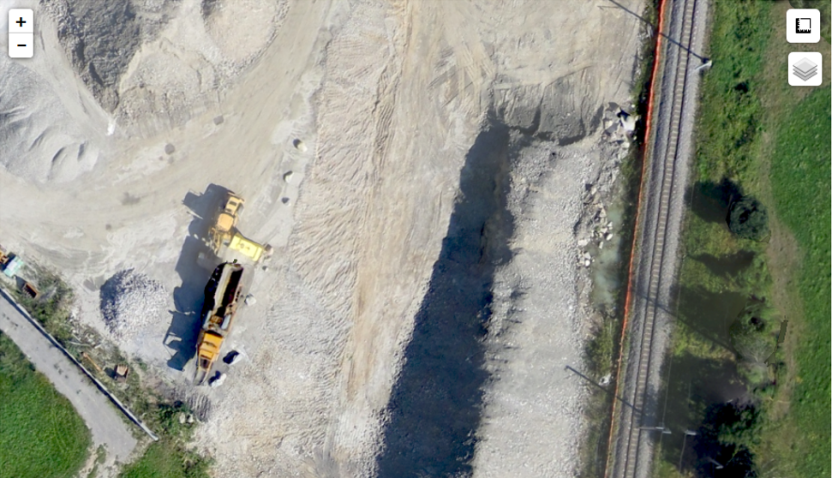
Construction
Drone with a standard (RGB) camera
Capture weekly images of construction site
Use ODM to generate orthophoto, 3D model
Use ODM linear, area, and volume measurements
Monitor as-built progress against plans
Visual updates for project stakeholders
Image: Stephen Mather

Slide 27
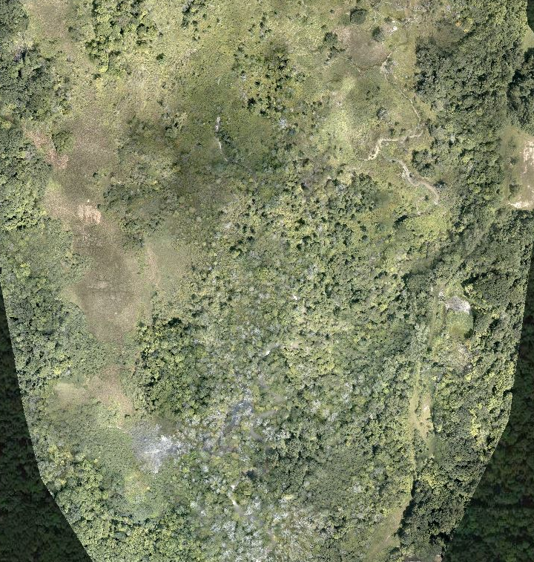
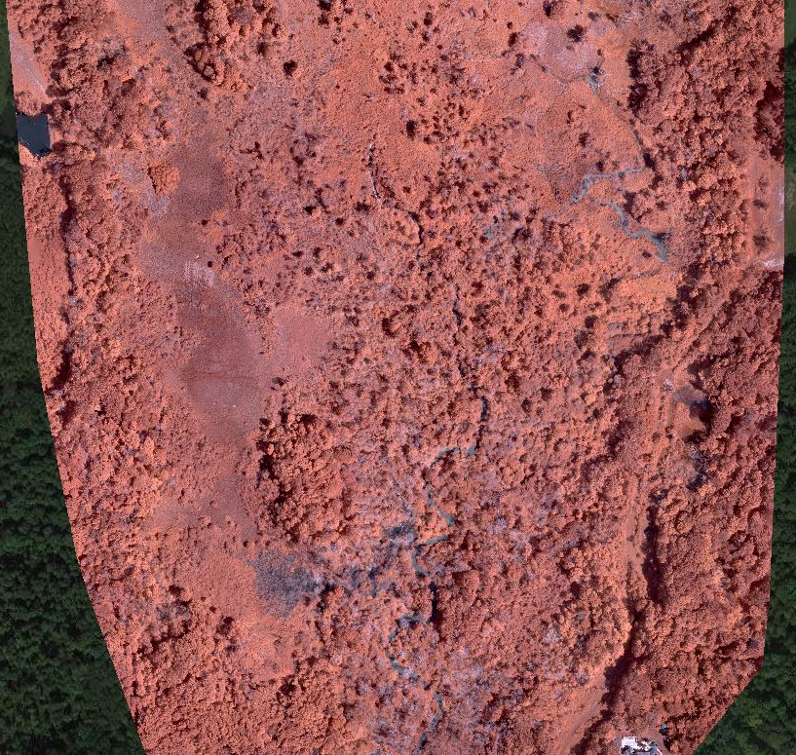
Ecological Assessment
Drone with RGB and NIR camera
Use ODM plant health algorithms and orthophoto
Identify areas of plant stress
Measure riparian area size
Repeat flights and processing to evaluate restoration efforts

Slide 28
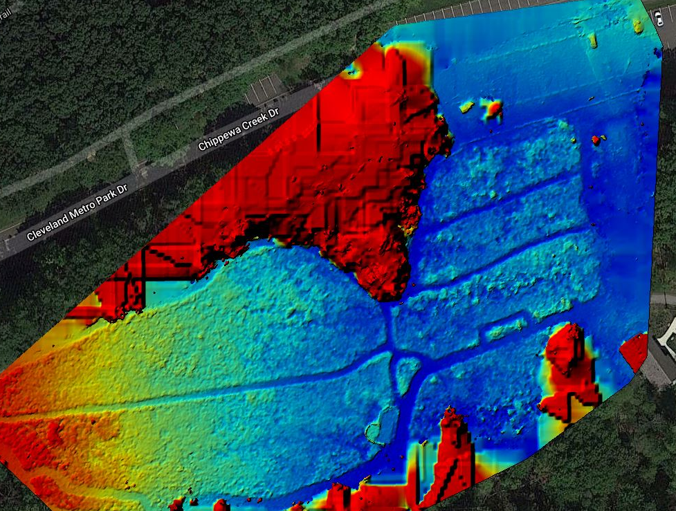
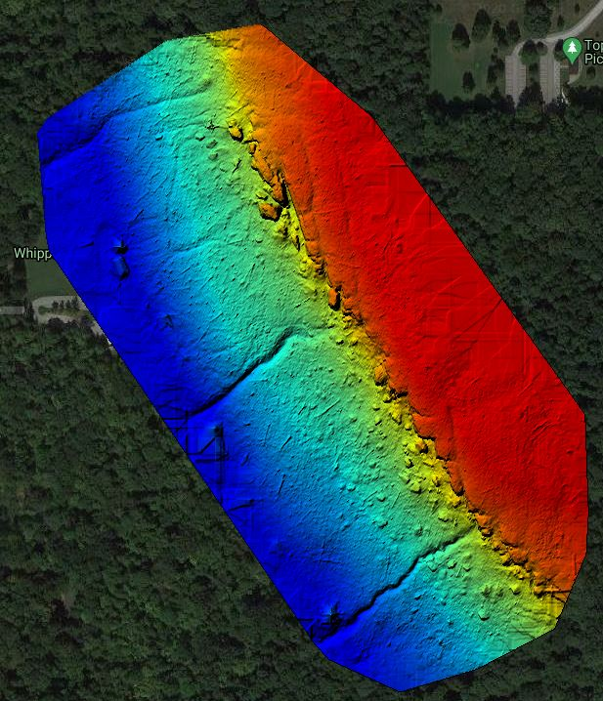
Erosion and Elevation Assessments
Drone with standard camera
Use ODM to generate DSM and DTM, respectively
Repeat flight and processing to monitor erosion over time
Export DEM for climbing maps

Slide 29
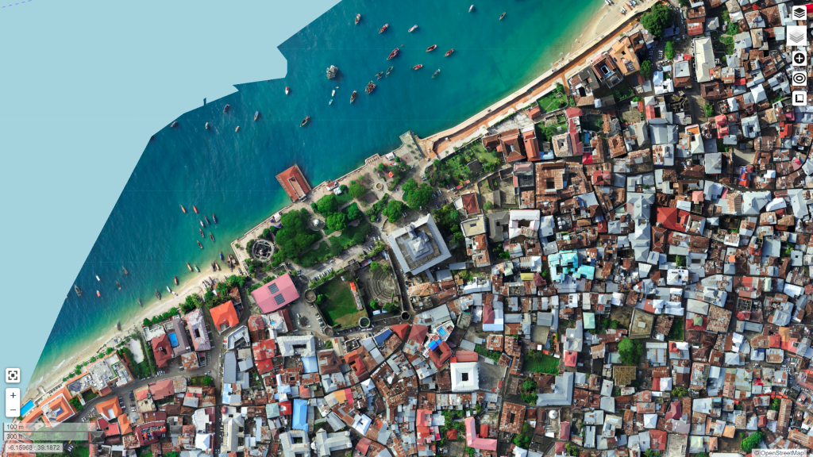
Coastal Monitoring
Drone with standard camera
Capture photos of a section of coastline
Use ODM to generate a 3D model
Repeat every 3 months
Export 3D models
Use another tool (e.g., CloudCompare) to assess change over time
Imagery via Zanzibar Mapping Initiative

Slide 30
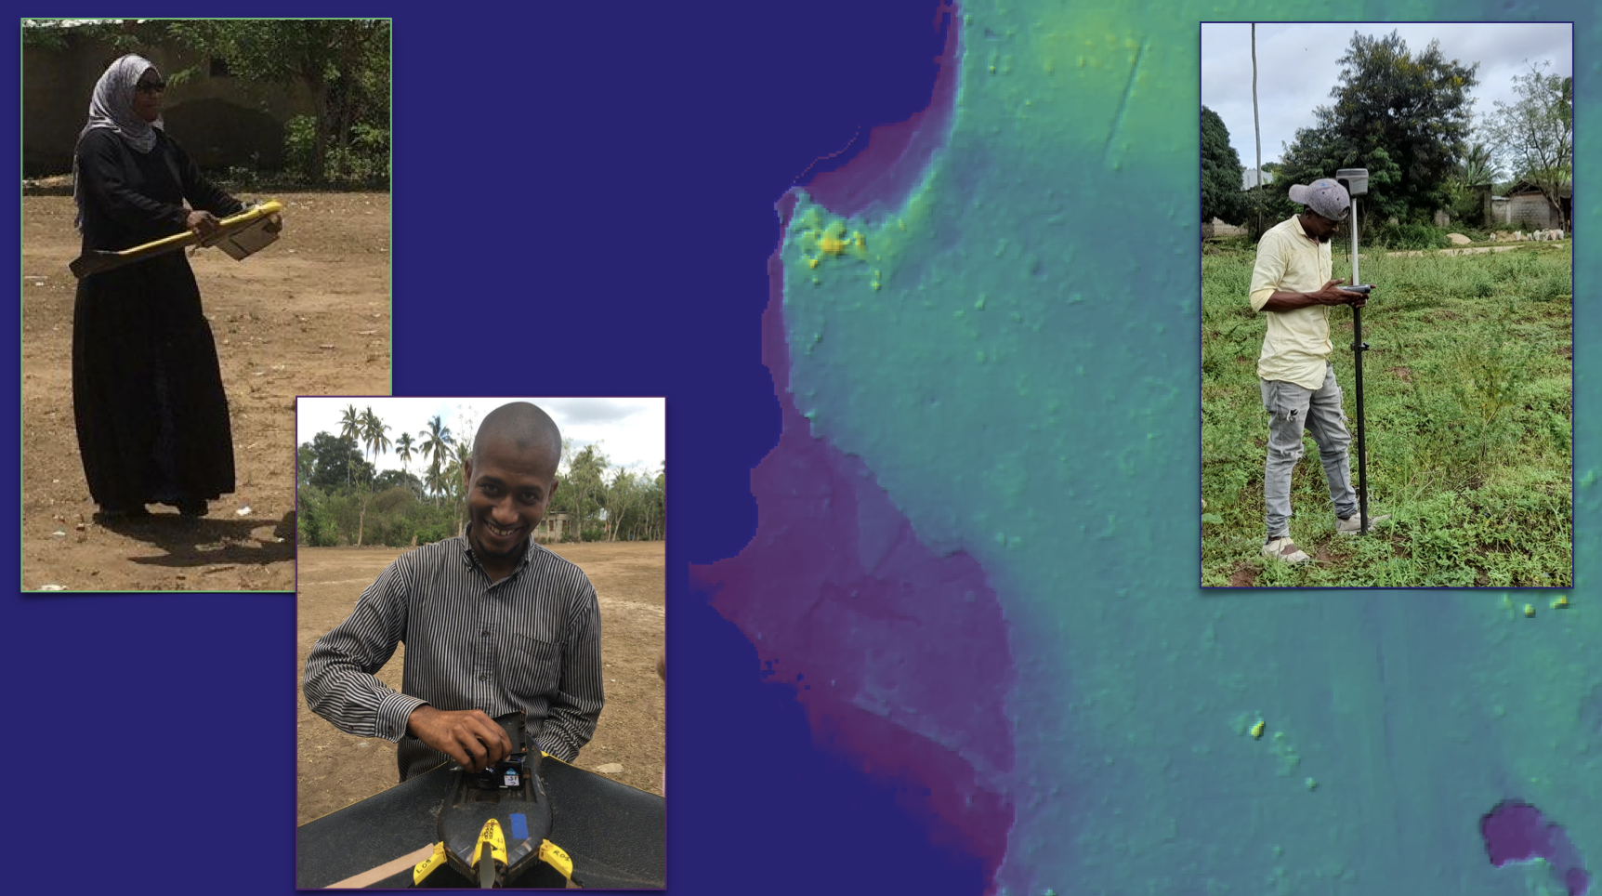
Digital Terrain Models for fluvial, pluvial, and coastal modeling – Zanzibar Mapping initiative
Imagery via Zanzibar Mapping Initiative

Slide 31
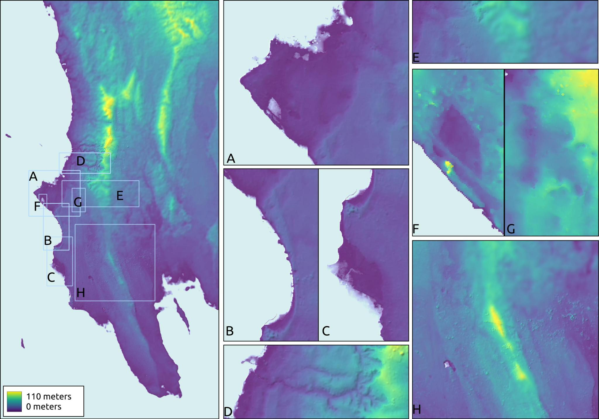


Slide 32
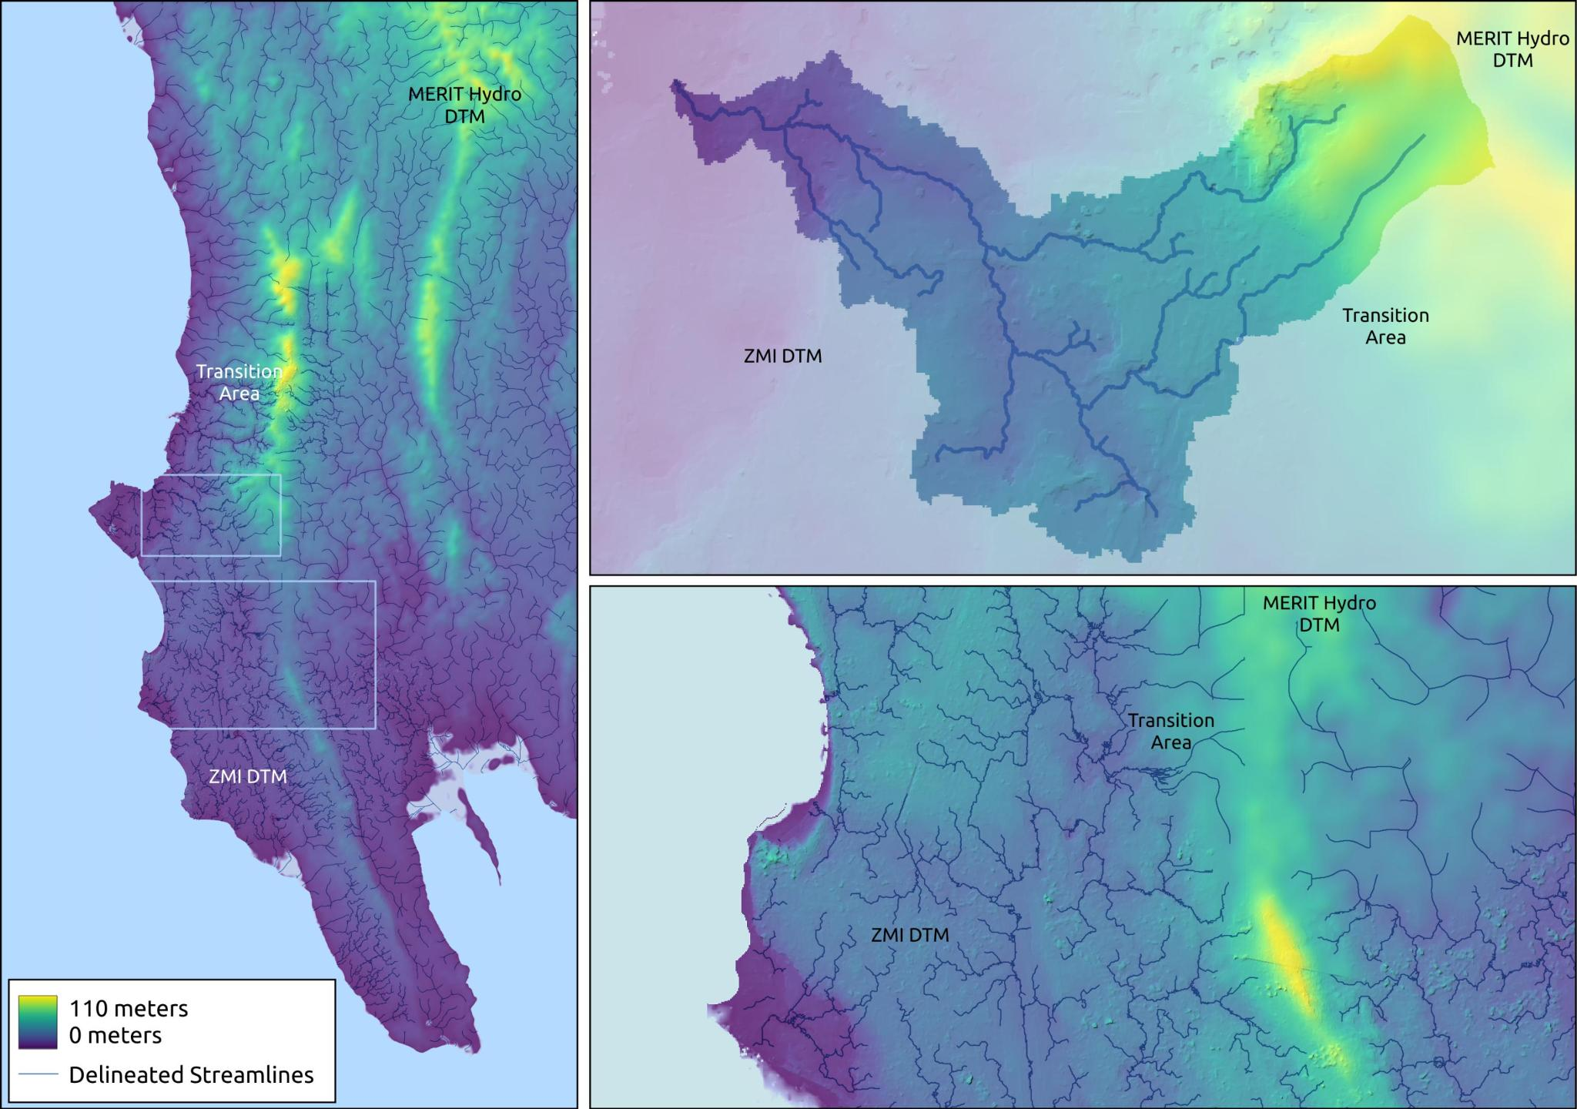

Slide 33
GETTING STARTED

Slide 34
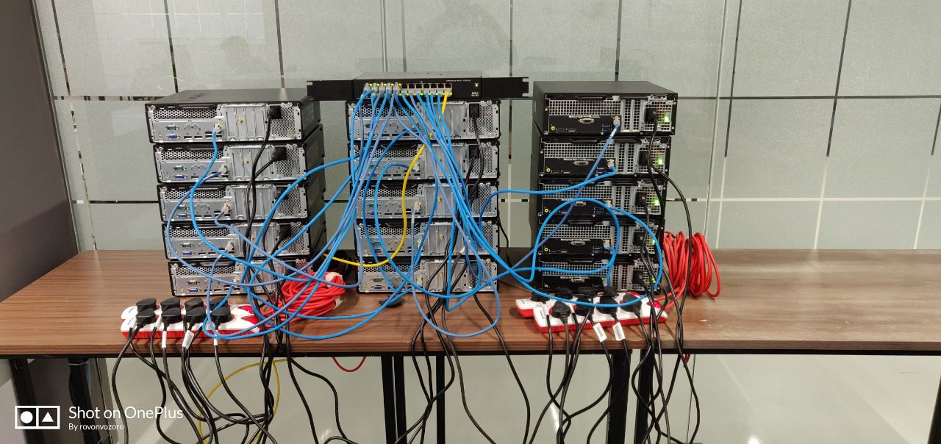
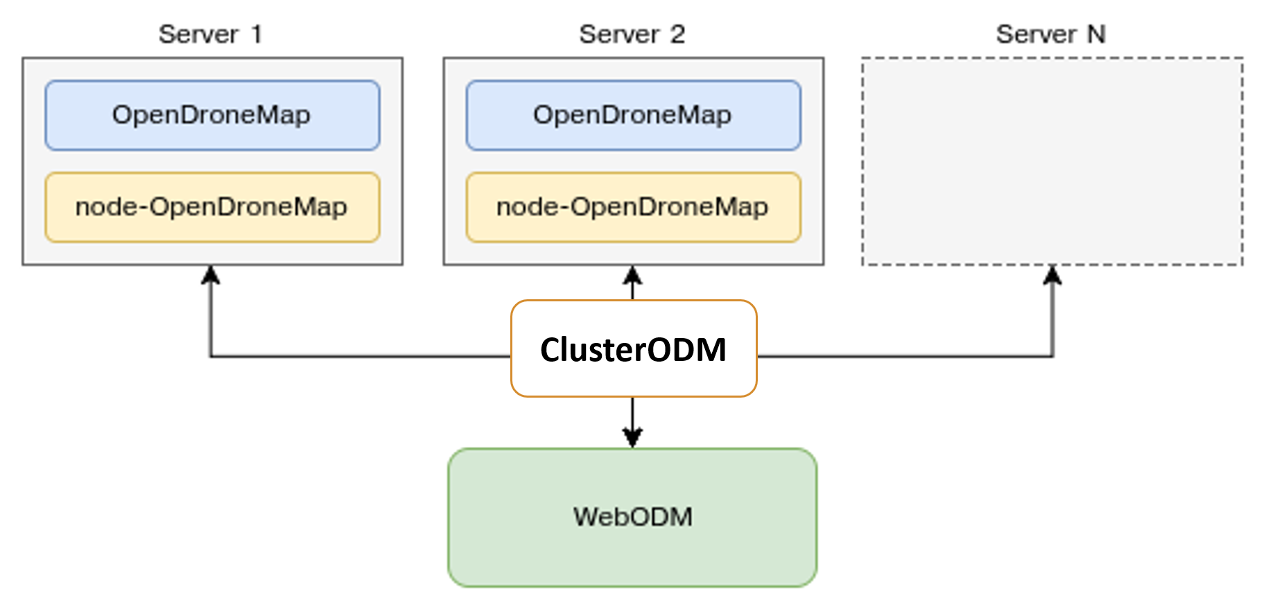
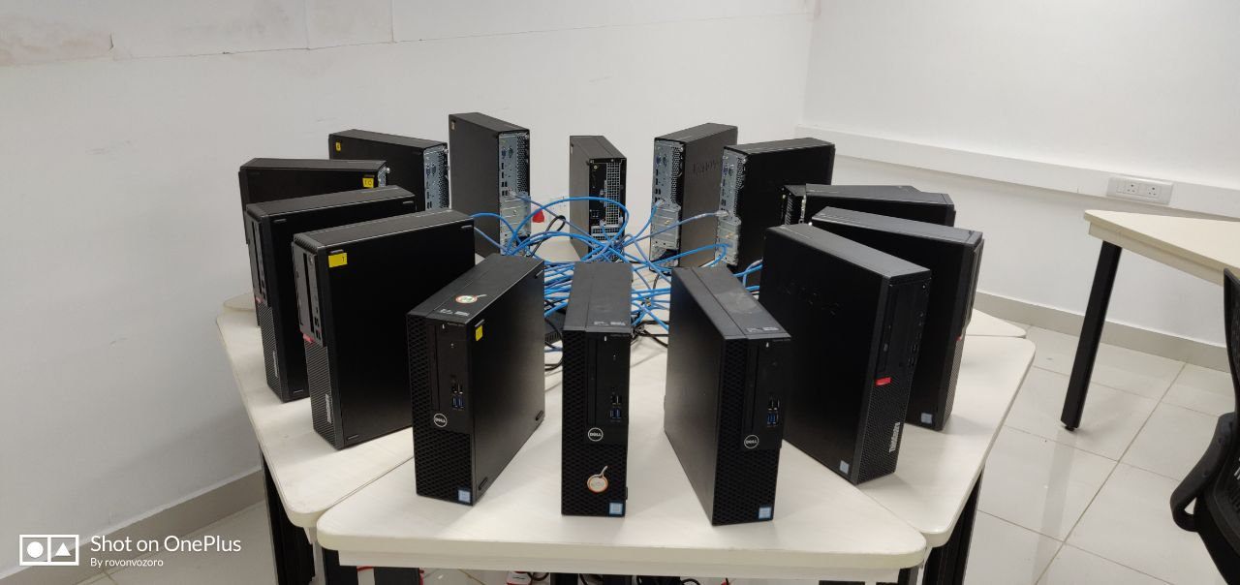
Architecture
70,000 – 90,000 images
Photo Credit: International Center for Free and Open Source Software, Kerala, India

Slide 35
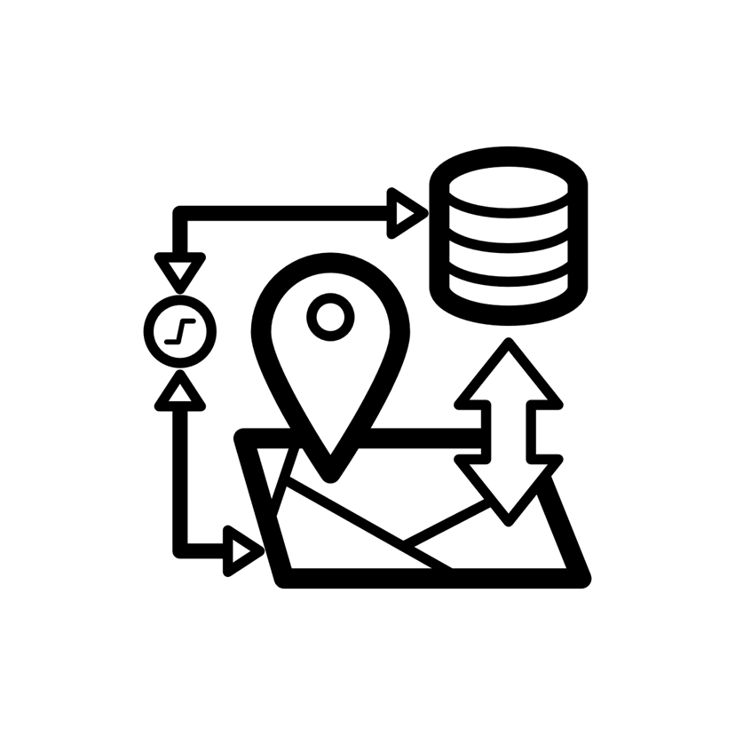
Supported Systems
Windows 10 (native, or Docker)
Ubuntu Linux (native, or Docker)
MacOS

Slide 36
System Requirements
Microsoft Windows or Linux preferred
Minimum 16 GB RAM
64+ GB preferred
Minimum 50 GB HDD
250+ GB preferred

Slide 37
Your First Dataset
Start small (~50 photos)
Use default settings
Then:
Increase # photos (250, 1000, 5000)
Refine configuration

Slide 38
Regional Distribution
Field
Int’l
Field
Field
Region
Field
Region
Field
Field
Field
Field

Slide 39
LEARNING MORE

Slide 40
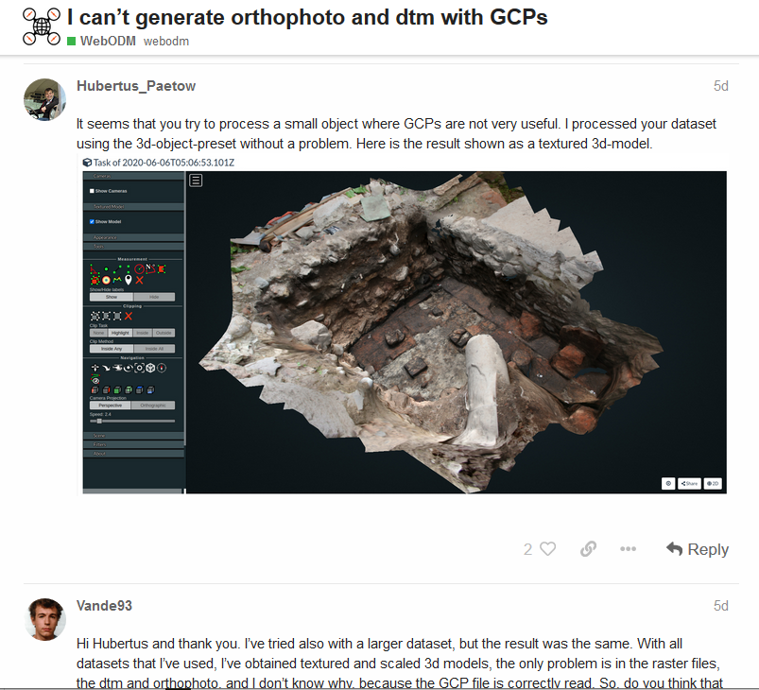
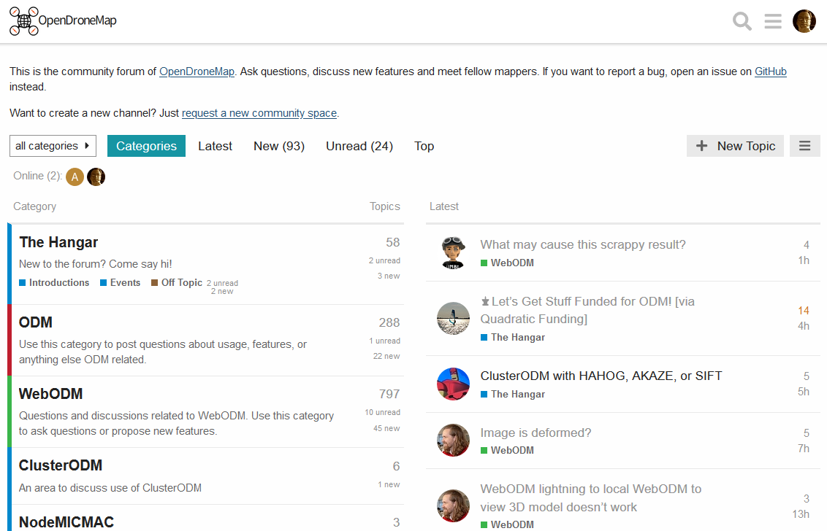
Community Forum
https://community.opendronemap.org

Slide 41
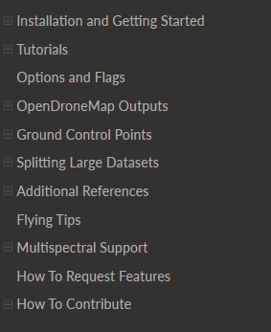
ODM Docs
https://docs.opendronemap.org

Slide 42
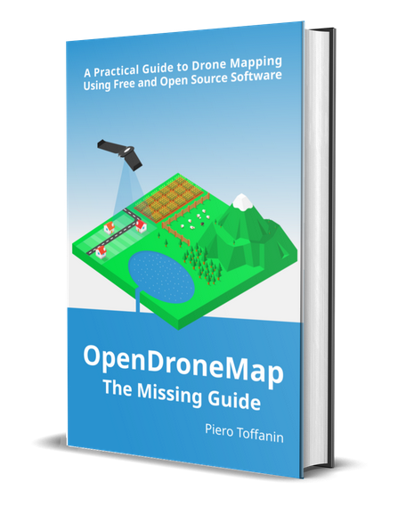
ODM Book
https://odmbook.com
$30
Image: odmbook.com

Slide 43
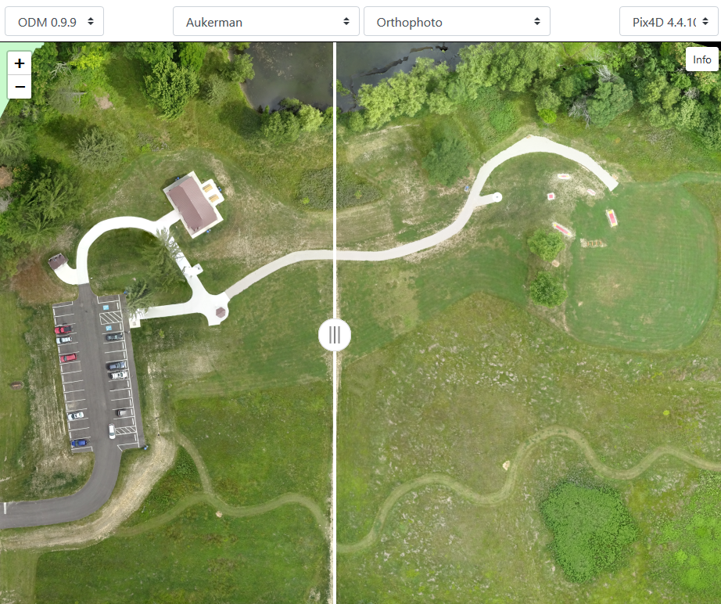
UAV Arena
Compare Outputs
ODM
Pix4D
DroneDeploy
Agisoft Metashape
DroneMapper
https://opendronemap.github.io/UAVArena/

Slide 44
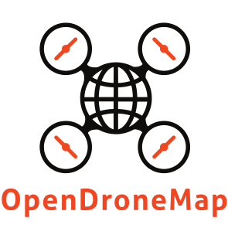
Sharing and Training
IFRC Special Interest Group
In-Depth Training and Workshops

Slide 45
GETTING INVOLVED

Slide 46
Ways to Get Involved
Community - https://community.opendronemap.org
Share Data
Share Code

Slide 47
Questions?
https://opendronemap.org
Presenter Contact
Presentation Credits
Stephen Mather stephen@smathermather.com @smathermather
Corey Snipes corey@twomile.com @coreysnipes
This presentation builds upon previous work by Piero Toffanin (UAV4GEO), Dakota Benjamin (Cleveland Metroparks), India Johnson (Cleveland Metroparks) and the presenters.
Screenshots and interface images by the presenters unless otherwise noted.
Some icons sourced from thenounproject.com
https://community.opendronemap.org

